Slide 2
Improve the icons:
Improve Icons descriped in the next pages.
Requirements:
Design Icon, Size: MxN pixel
Copy the ICON’s into a empty grid in the album file: album.png,
Provide the (x y) coordinate of its lower-left corner in the album
Note: (0, 0) is the top-left corner of the image

Slide 3
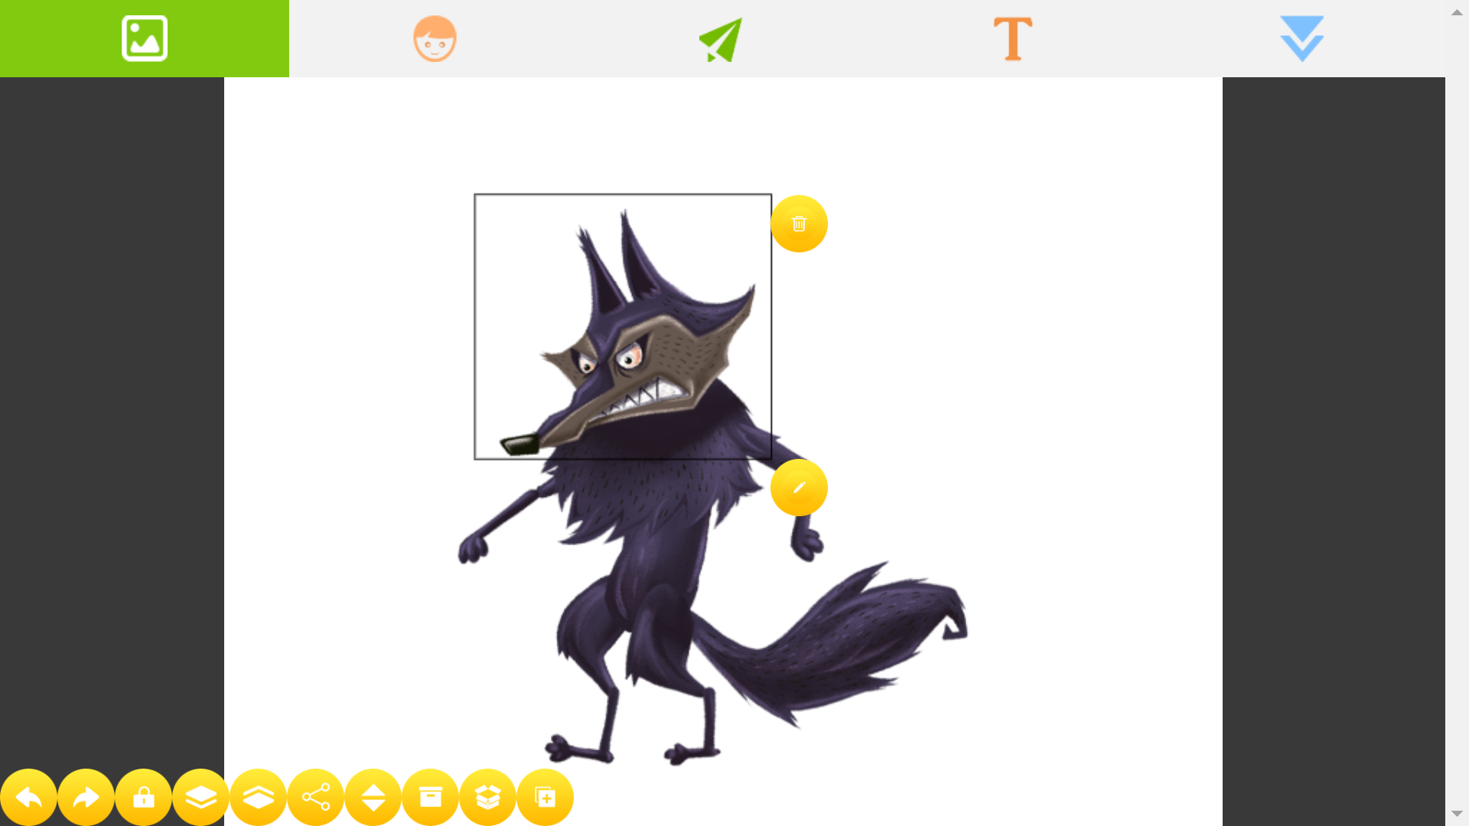
Limit Moving Scope of the Joint, 1) Move Joint to lower angles,
2) Click this icon,
3) Move bone to the upper angle,
4) Click this icon again to accept the new lower/upper angle

